Slide 1
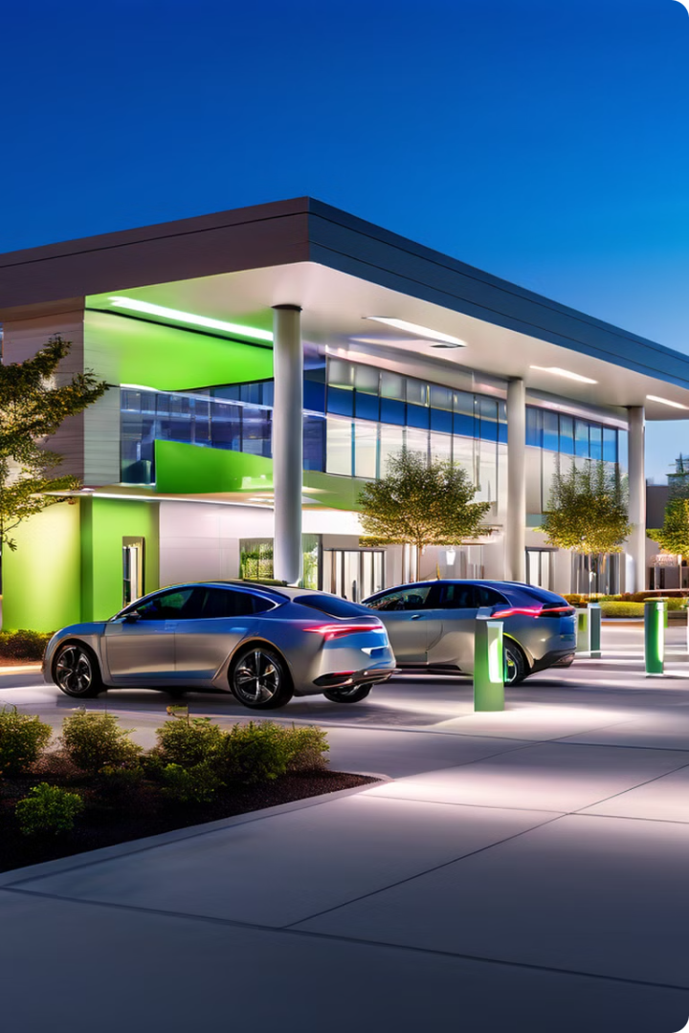
ABC Corporation: Parking Lot Monetization Project
ABC Corporation presents an innovative project to monetize its underutilized parking lot. This proposal aims to transform our 50-car capacity lot into a revenue-generating asset while maintaining employee benefits and opening for public use.
By: Group 4
Michael Ajeboriogbon, Emmanuel Amoah, Pramila Poudel,
Prabesh Rai, Amisha Shrestha
NY

Slide 2
Project Background
Location
Current State
Opportunity
ABC Corporation's headquarters in Ottawa, Canada, featuring a 50-car capacity parking lot.
Basic lighting, no markings, no CCTV. Guarded by a single Parking Agent.
Monetize underutilized space due to increased remote work and public transit adoption.

Slide 3
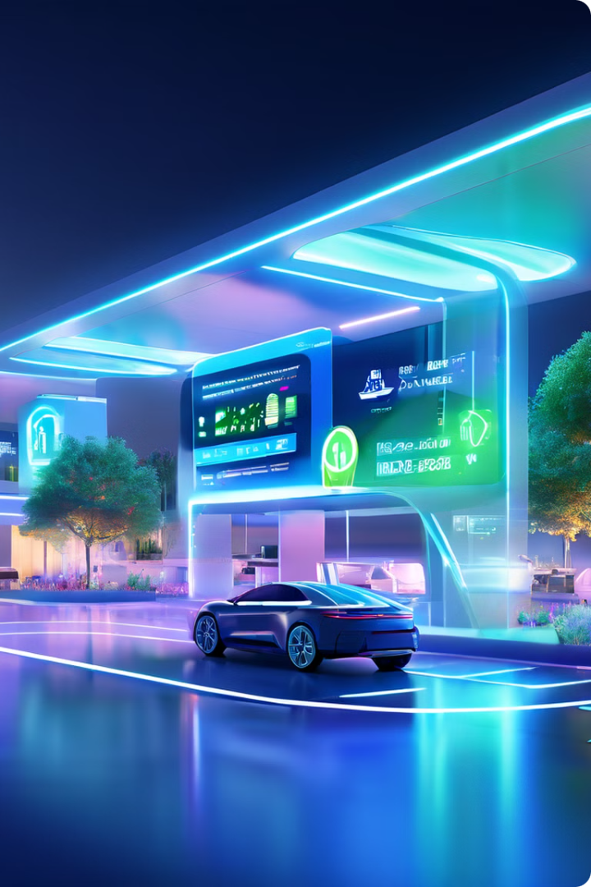
Project Objectives
1
Monetization
Open parking to the public during non-peak hours and weekends, generating additional revenue.
2
Operational Efficiency
Implement automated systems for smooth operations with minimal disruptions.
3
Customer Experience
Create a convenient, safe, and user-friendly parking facility for both employees and public users.

Slide 4
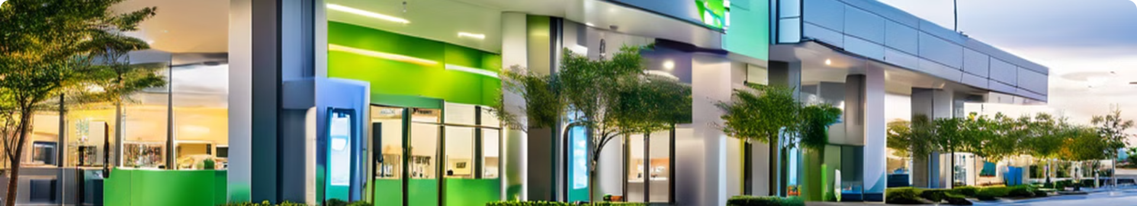
Desired Outcomes
Space Optimization
Automation
50 marked spaces, including 5 accessible and 15 with electric chargers.
Automated check-in/out and payment system with emergency help-desk support.
Security
Pricing Strategy
Comprehensive CCTV coverage, especially at the entrance and exit points.
Competitive hourly rate for public users, while maintaining free parking for employees.

Slide 5
Project Timeline
1
Planning
Develop detailed project plan, allocate resources, and obtain necessary approvals.
2
Procurement
Source and purchase required materials, equipment, and technology solutions.
3
Implementation
Install new systems, mark spaces, and set up security infrastructure.
4
Testing
Conduct thorough testing of all systems and processes to ensure smooth operation.
5
Launch
Go live with the new parking system and monitor initial performance.

Slide 6
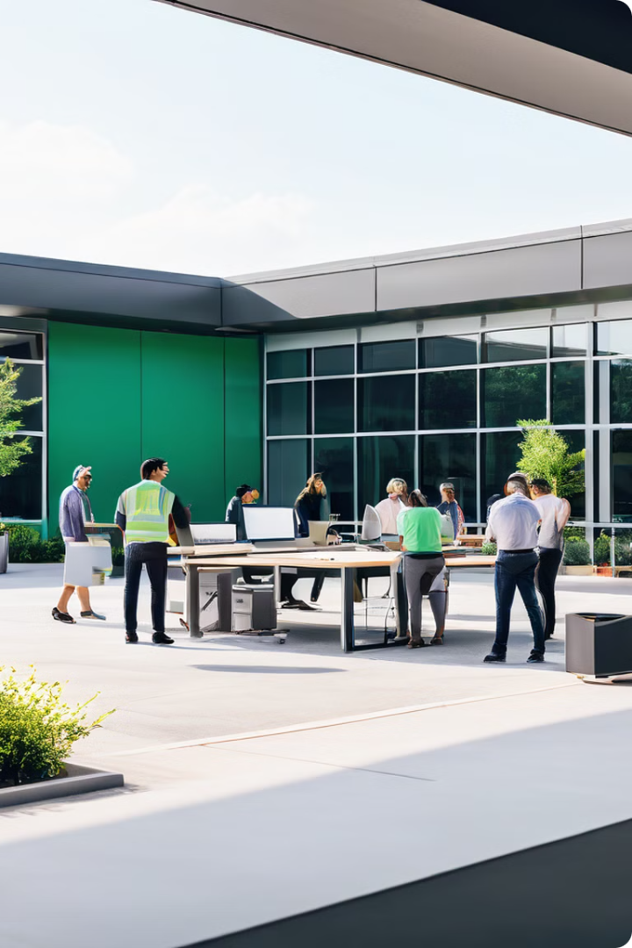
Resource Requirements
Role
Hourly Rate
Estimated Hours
Project Manager
$50/hr
160
Engineers
$40/hr
240
Technicians
$30/hr
320
Security Experts
$35/hr
80

Slide 7
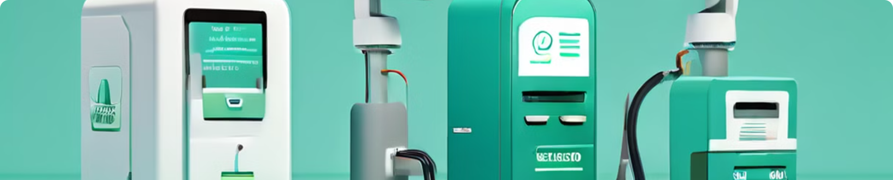




Material Requirements
Marking Paint
Electric Chargers
CCTV Cameras
Automated Systems
High-quality, durable paint for clear space demarcation.
15 state-of-the-art EV charging units to accommodate growing demand.
High-resolution cameras for comprehensive lot surveillance.
Advanced check-in/out and payment systems for efficient operations.

Slide 8
Cost Analysis and Pricing Strategy
Project Costs
Pricing Strategy
Revenue Projections
Total estimated cost: $250,000, including labor, materials, and additional expenses.
Proposed public rate: $3/hour. Employees park free with ID verification.
Estimated annual revenue: $180,000, based on 60% utilization during available hours.

Slide 9





Operational Considerations
Capacity Management
Real-time updates on a website/app. Nearby parking suggestions when full.
Violation Handling
Automated alerts for improper parking. Fines and towing policies for non-compliance.
Security Measures
24/7 CCTV monitoring and help-desk support for enhanced safety.
Maintenance
Regular system checks and updates to ensure optimal performance.

Slide 10

Conclusion and Next Steps
1
Project Benefits
2
Risk Mitigation
3
Call to Action
Increased revenue, improved efficiency, and enhanced corporate image.
Comprehensive security measures and continual performance monitoring.
Seeking management approval to proceed with detailed planning and implementation.

